Slide 1

Tech Pay Shift — Global Compensation & Remote Work Dynamics (2020–2024)
Kaggle DS Salaries + World Bank GDP (PPP)
Interactive Visualization Project
Sahej Vasandi & Yashoneel Bingley

Slide 2
Motivation
How did the rapid expansion of remote work structurally reshape global tech compensation between 2020–2024?
Is salary growth homogeneous across roles and geographies, or does it exhibit structural divergence?
Does remote work enable cross-border purchasing power arbitrage by decoupling compensation from local GDP baselines?
Why must we move beyond averages and examine full distributional shifts to understand labor-market transformation?

Slide 3

The Data
Primary Dataset
Kaggle – Data Science Salaries (2020–2024)
https://www.kaggle.com/datasets/ruchi798/data-science-job-salaries
4,000+ global tech salary records
Salary (USD standardized)
Experience level
Remote ratio (0%, 50%, 100%)
Company location & employee residence
Macroeconomic Dataset
World Bank – GDP per Capita (PPP, Current International $)
https://data.worldbank.org/indicator/NY.GDP.PCAP.PP.CD
Country-level GDP adjusted for purchasing power parity
Enables cross-country economic normalization

Slide 4

Dataset Uniqueness
Integrated micro-level salary data with macro-level economic indicators
Constructed a derived metric: Salary-to-GDP (PPP) Ratio
Enables structural comparison of compensation relative to national economic baselines
Captures global remote labor-market decoupling
Multi-year window (2020–2024) allows post-pandemic temporal analysis

Slide 5
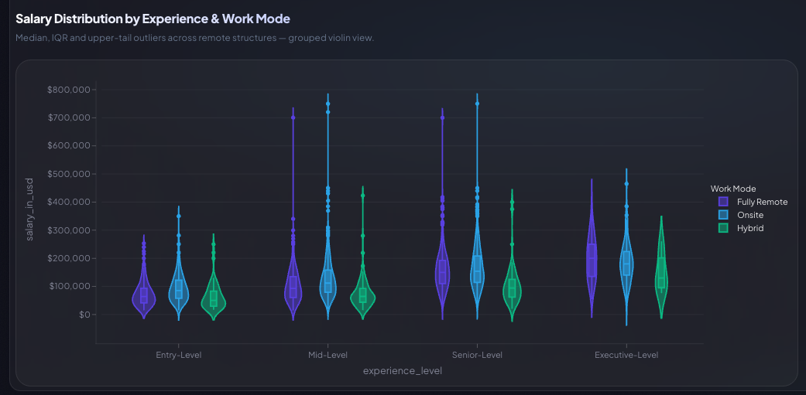
Salary Distribution by Experience & Work Mode

Slide 6
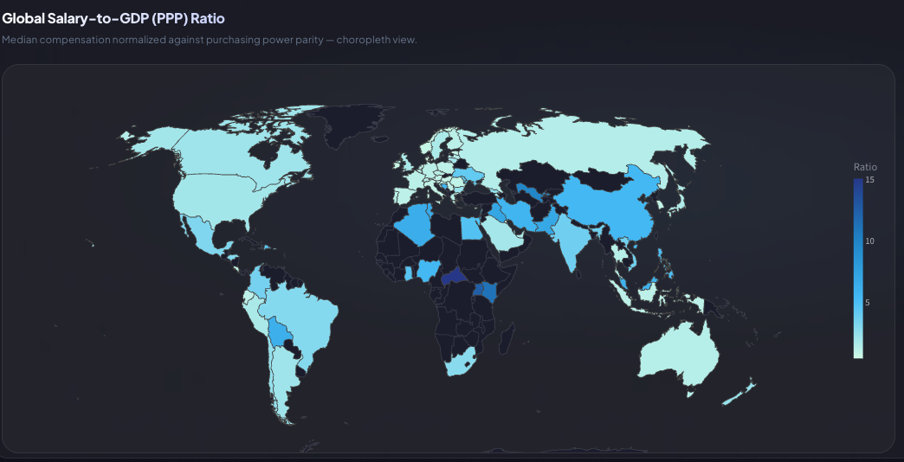
Global Salary-to-GDP (PPP) Ratio

Slide 7
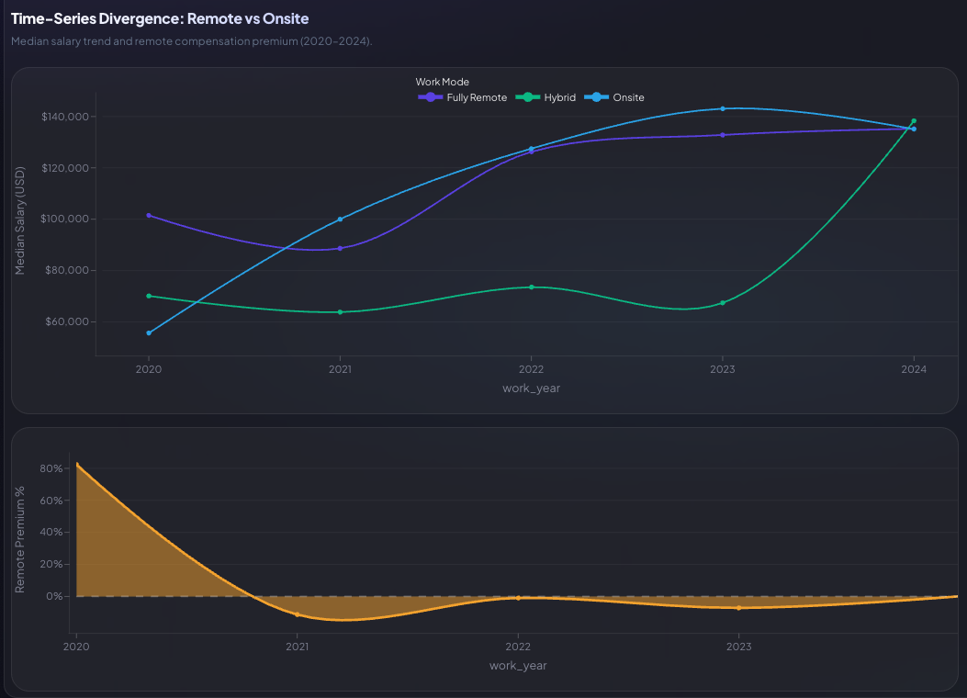
Time-Series Divergence: Remote vs Onsite

Slide 8
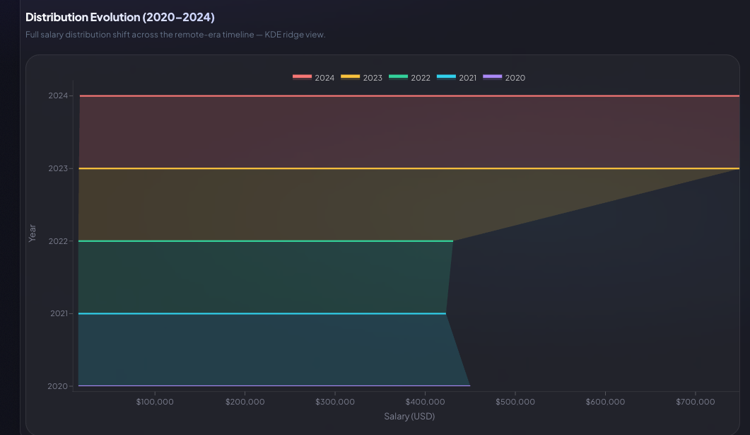
Distribution Evolution (2020–2024)

Slide 9
The Remote Compensation Story (2020–2024)
2020–2021
Remote work changed how companies paid tech workers.
2022–2023
High salaries grew fastest, especially at senior levels.
Emerging Markets
Remote jobs increased global earning power differences.
2024
Salary growth slowed and began to stabilize.

Slide 10
Audience & Impact
Who Is This For?
Policy Analysts Studying global wage inequality and purchasing power dynamics
Tech Companies Designing fair and competitive remote compensation models
Economists & Labor Researchers Analyzing globalization and structural wage divergence
Students & Data Practitioners Learning how to interpret distributional shifts beyond averages
Why It Matters
Remote work is not just a workplace trend, it is reshaping global compensation structures and economic balance.

Slide 11

Process & Learning
Shifted from relying on averages to analyzing full distributions, revealing inequality and upper-tail dynamics that summary statistics hide
Applied PPP normalization to connect micro-level salary data with macroeconomic context, enabling meaningful global comparison
Designed a structured, multi-tab interactive dashboard to guide users from distribution → geography → time divergence → inequality
Learned that effective visualization is not just technical accuracy, it requires narrative clarity, intentional design, and audience awareness

Slide 12
Take Home Message
Remote work structurally repriced global technical labor, reshaping compensation patterns across experience levels and geographies
Salary growth was concentrated in upper distribution tiers, indicating divergence rather than uniform uplift
Compensation became increasingly decoupled from national GDP baselines, enabling cross-border purchasing power effects
Distribution-aware visualization reveals structural labor-market shifts more effectively than summary statistics alone

